Slide 1
FIT FOR LIFE 31.5 -1.6 2010
MATTLIDENS SKOLA
I två dagars tid fick eleverna i årskurs nio i Mattlidens skola en möjlighet att lära sig om livräddning, brandsläckning samt första hjälp.
Ledarna för samtliga stationer var kunniga proffs vilket gjorde projektet lyckat och lärorikt.

Slide 2
Comment
”I learned important things”.
”Johanna was a great teacher”
”We learned to save peoples lives. It was very nice and it`s good to know those things”
”Pretty obvious and repetitive, I didn´t learn anything new really”
”I think it was very important to learn first –aid and what to do in case of fire. And we
had professional teachers. That is good”.
” It was very interesting and I learned many new important things. Everyone should know how to do when you find a person in danger”
”Education went up in smoke”
”Unnecessary”
”Very interesting and useful, though most students weren´t concentrating – we should have it earlier”
”it was a mangneficent experience”
”Boring but important”
”Swimming was nice”
”It was very useful but the part with the fire was very boring”
”Of cause it was useful, but some of the parts were awfully boring and you couldn´t concentrate properly”

Slide 3
”I belive as many before me that the swimming part was the most useful. It could be good to skip the most basic parts like the section we were taught that we shouldn´t extingnish electrical stuff in fire with water”
”Fun but ”slutprojektet” would have been better…”
”It was fun”
”it was ”lame” the lifesaving in water was good”
”The lifesaving – part was fun and I learn´t a lot”
”There is no words to describe the horrifying feeling of shizzy helping”
”The baseball part was fun when you could just chill in the sun”
”Both days were fun”
”Yes, i did like it”
”It was very fun, but the fire part was a little stupid”
”I learned a lot, it was okay”
”It was OK. The swimming was not that fun”
”It was fun. There was a lot off stuff I already knew but also many new things”

Slide 4
”It was okay. We learned a few things but it was pretty boring… useful but boring”
”We learned o lot, and it´s probably good to know those things”as really impotant
”I learned a lot at it was fun”
”I learned a lot and it was fun but the swimming was boring but good to learn”
”Lifesaving was fun, firstaid was important to me and fun”
”I learnes some ńew stuff. It was good to have somebody to tell you these things even though you already know them”
”I learned a lot. Though it was pretty boring☺ Boboll was not necessary. All the first aid stuff could have taken half of the time it did”
”The lifesaving was really important to learn but the fire exercise was boring and not that hard”
” Lifesaving = OK”
”Fire = somewhat useless”
”First aid =useable”

Slide 5
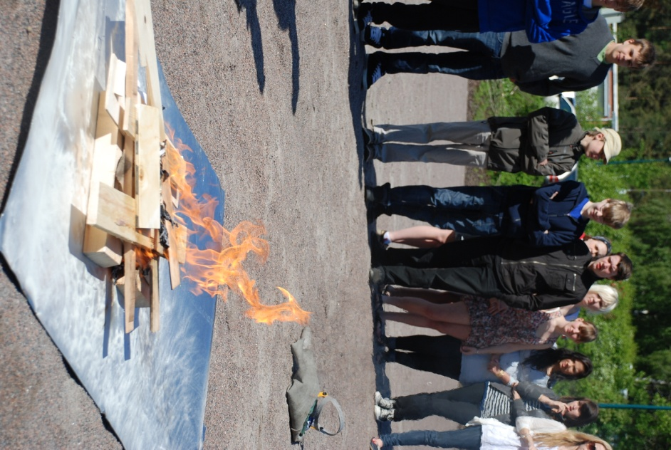
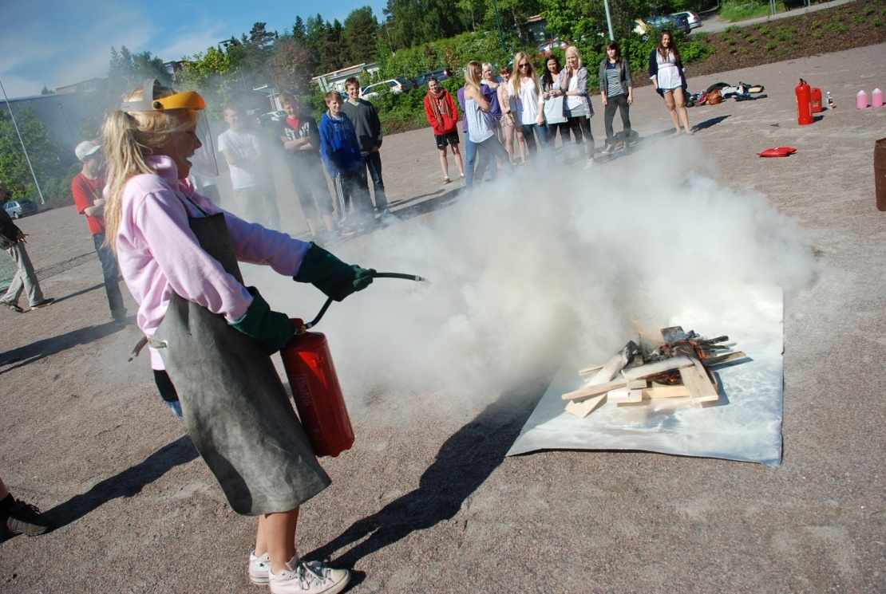
Brandövningar

Slide 6
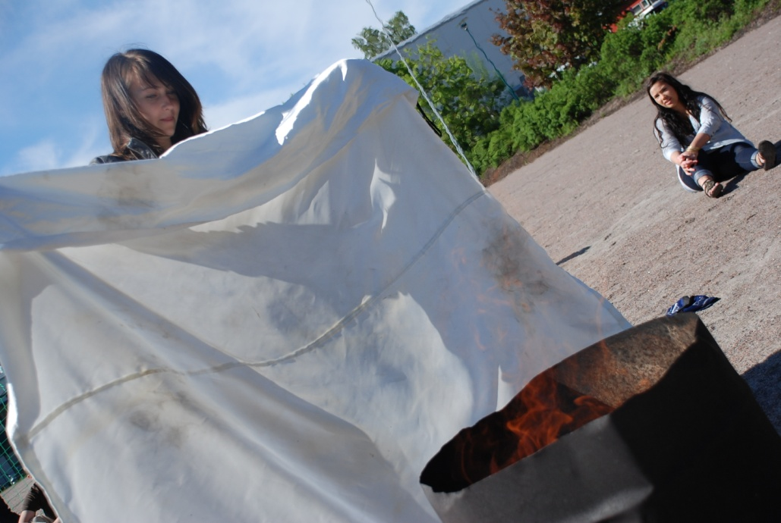
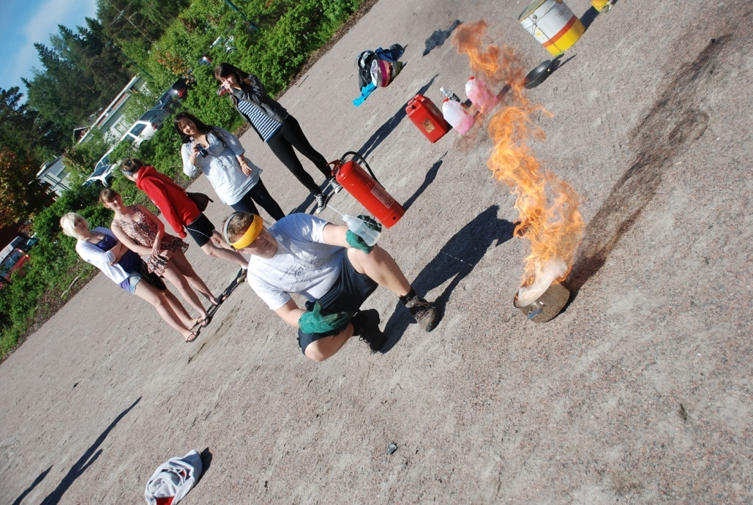

Slide 7
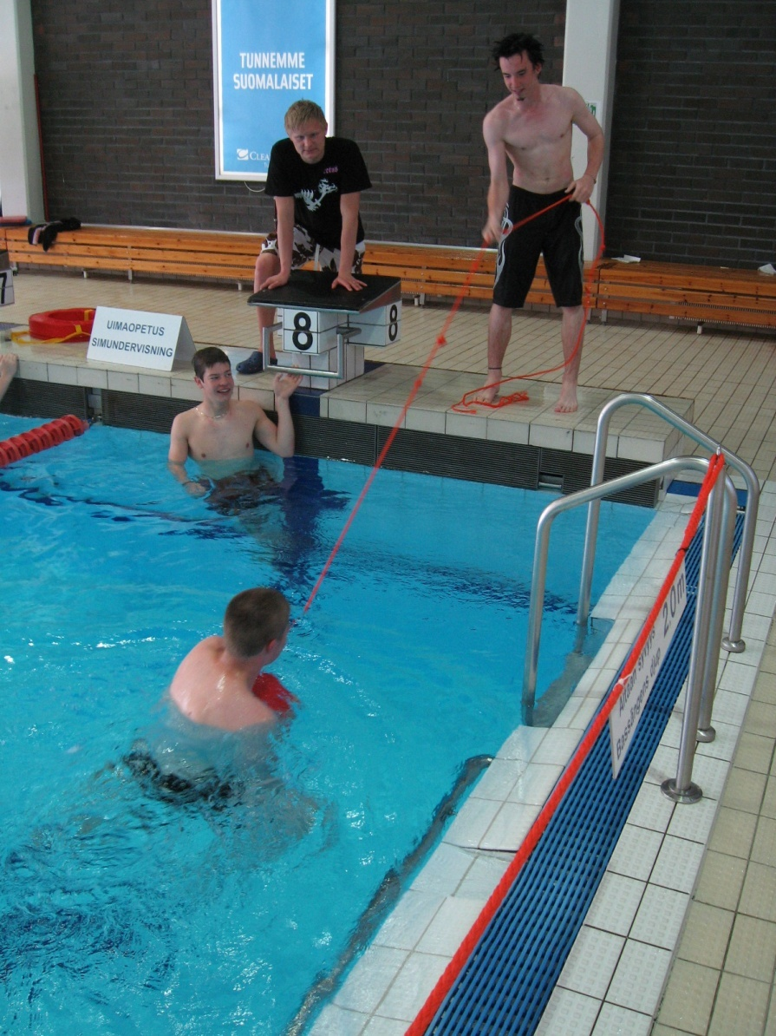
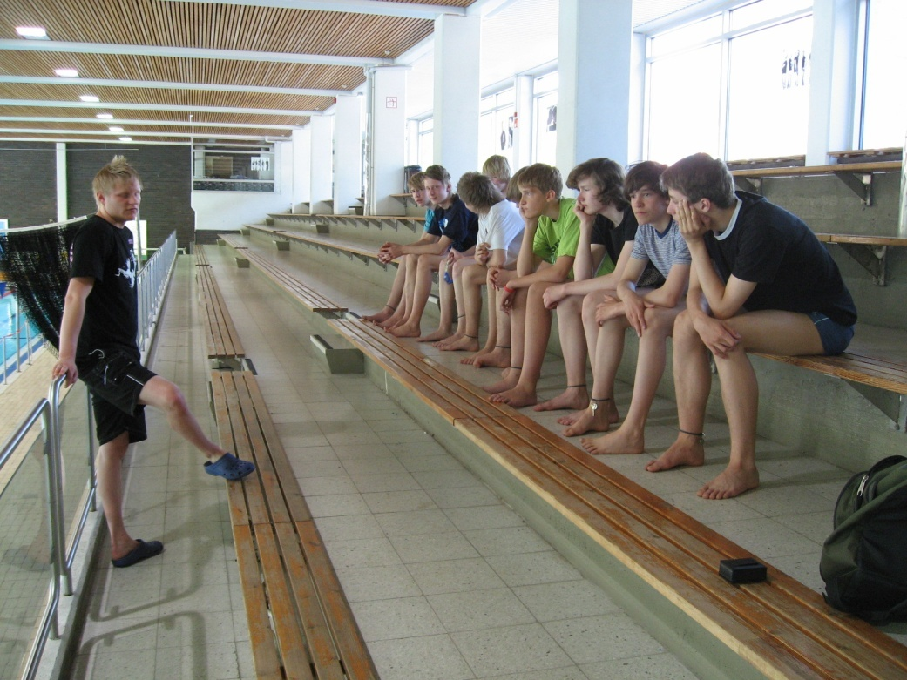
Livräddning

Slide 8
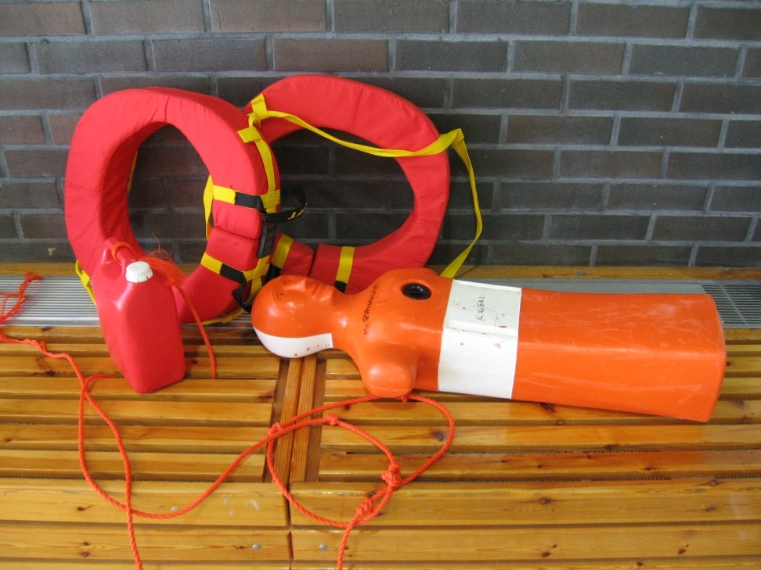
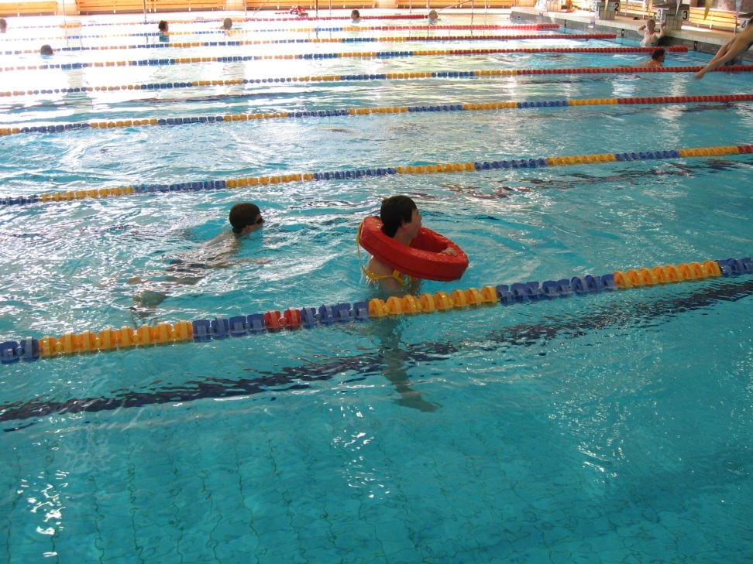

Slide 9
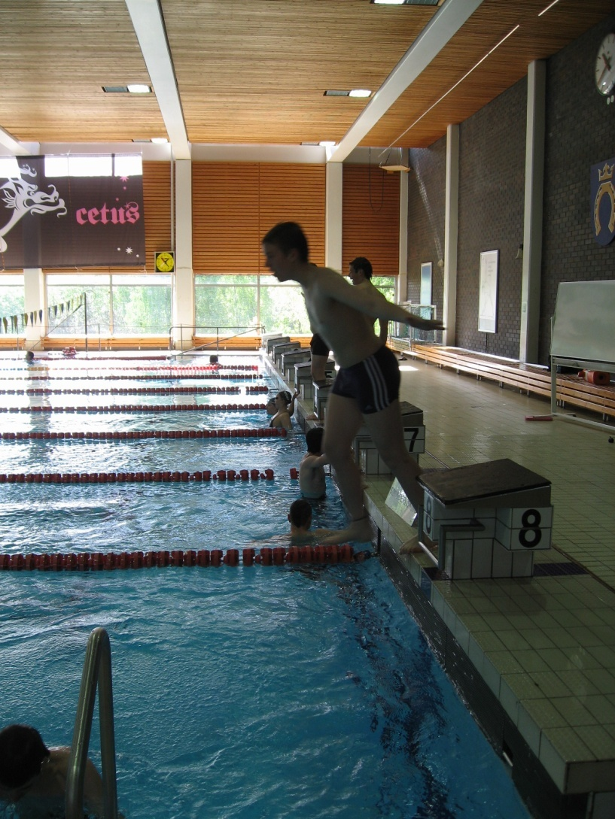

Slide 10
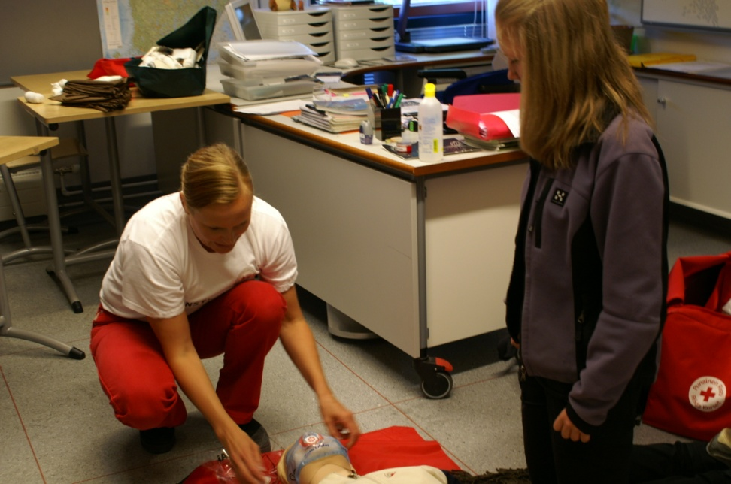
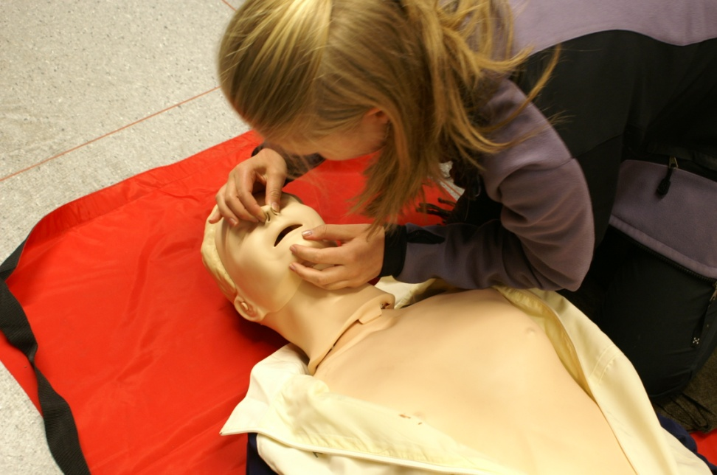
Första hjälp

Slide 11
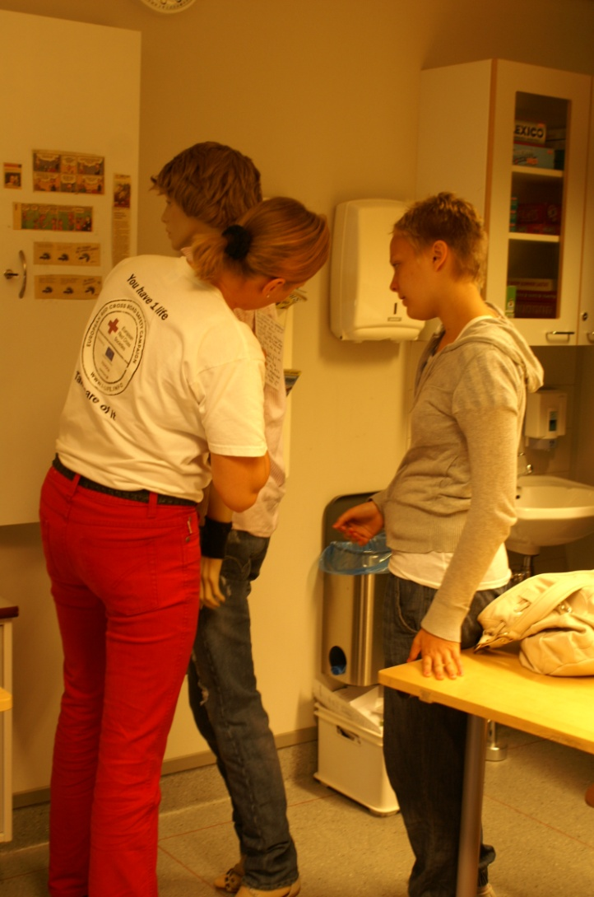
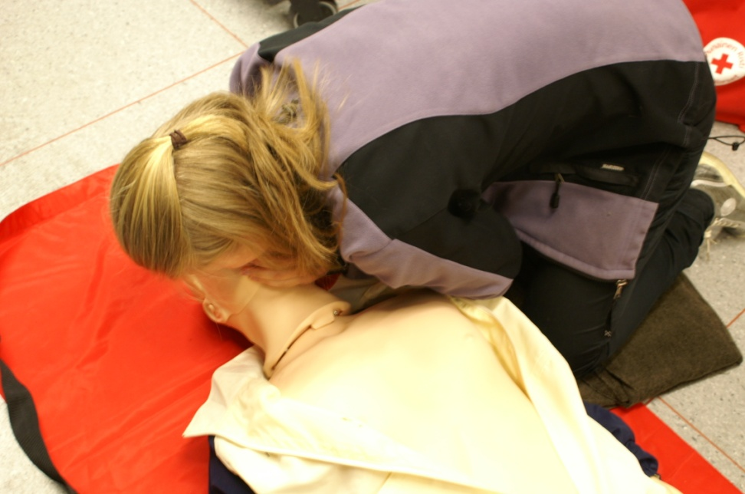

Slide 12
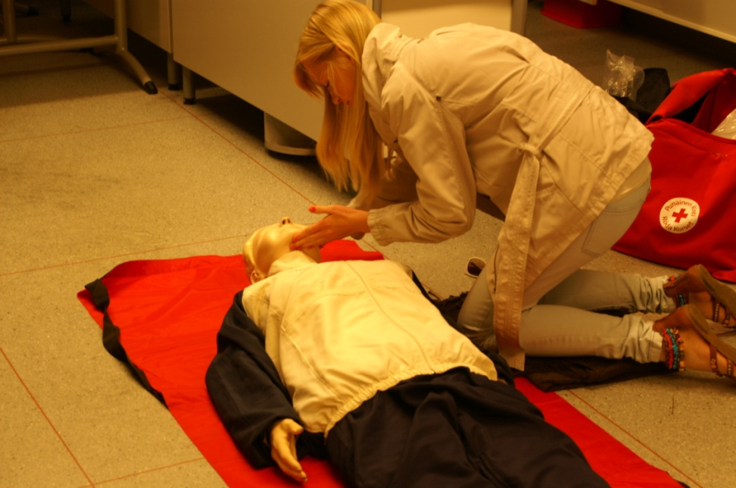
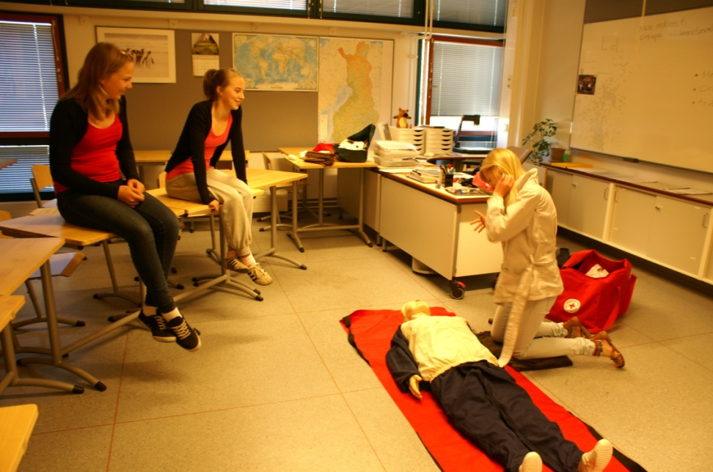

Slide 13
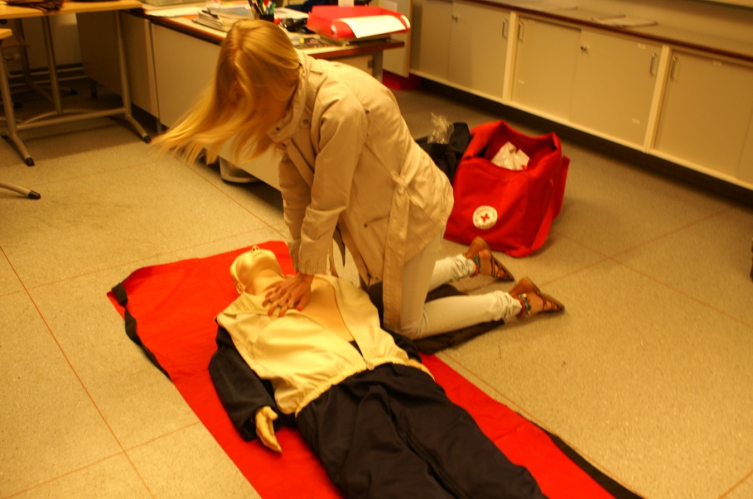
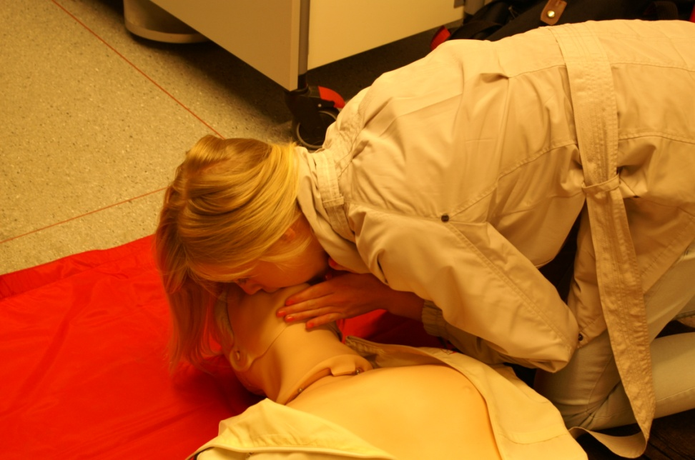

Slide 14
